Slide 1
Introduction
Example: model train controller.
© 2000 Morgan Kaufman
Overheads for Computers as Components 2nd ed.

Slide 2
Purposes of example
Follow a design through several levels of abstraction.
Gain experience with UML.
© 2008 Wayne Wolf
Overheads for Computers as Components 2nd ed.

Slide 3
Model train setup
rcvr
motor
power
supply
console
ECC
command
address
header
© 2008 Wayne Wolf
Overheads for Computers as Components 2nd ed.

Slide 4
Requirements
Console can control 8 trains on 1 track.
Throttle has at least 63 levels.
Inertia control adjusts responsiveness with at least 8 levels.
Emergency stop button.
Error detection scheme on messages.
© 2008 Wayne Wolf
Overheads for Computers as Components 2nd ed.

Slide 5
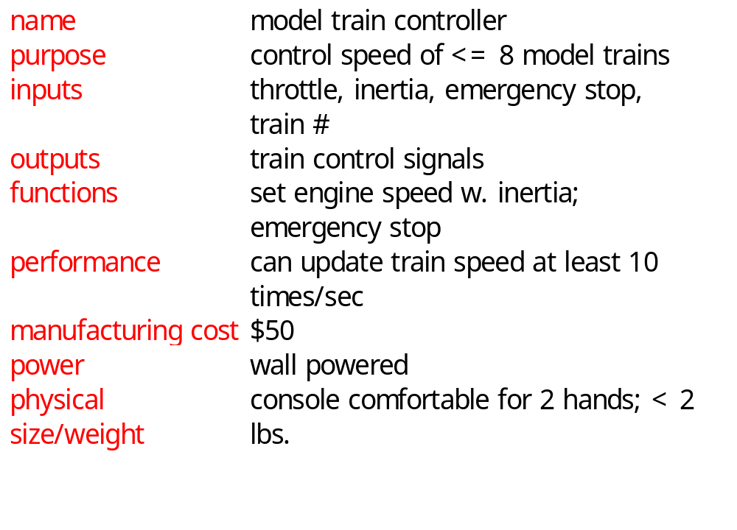
Requirements form
© 2008 Wayne Wolf
Overheads for Computers as Components 2nd ed.

Slide 6
Digital Command Control
DCC created by model railroad hobbyists, picked up by industry.
Defines way in which model trains, controllers communicate.
  Leaves many system design aspects open, allowing competition.
This is a simple example of a big trend:
  Cell phones, digital TV rely on standards.
© 2008 Wayne Wolf
Overheads for Computers as Components 2nd ed.

Slide 7
DCC documents
Standard S-9.1, DCC Electrical Standard.
  Defines how bits are encoded on the rails.
Standard S-9.2, DCC Communication Standard.
  Defines packet format and semantics.
© 2008 Wayne Wolf
Overheads for Computers as Components, 2nd ed.

Slide 8
DCC electrical standard
Voltage moves around the power supply voltage; adds no DC component.
1 is 58 μs, 0 is at least 100 μs.
logic 1
logic 0
time
58 μs
>= 100 μs
© 2008 Wayne Wolf
Overheads for Computers as Components 2nd ed.

Slide 9
DCC communication standard
Basic packet format: PSA(sD)+E.
P: preamble = 1111111111.
S: packet start bit = 0.
A: address data byte.
s: data byte start bit.
D: data byte (data payload).
E: packet end bit = 1.
© 2000 Morgan Kaufman
Overheads for Computers as Components

Slide 10
DCC packet types
Baseline packet: minimum packet that must be accepted by all DCC implementations.
  Address data byte gives receiver address.
  Instruction data byte gives basic instruction.
  Error correction data byte gives ECC.
© 2008 Wayne Wolf
Overheads for Computers as Components, 2nd ed.

Slide 11
Conceptual specification
Before we create a detailed specification, we will make an initial, simplified specification.
  Gives us practice in specification and UML.
  Good idea in general to identify potential problems before investing too much effort in detail.
© 2008 Wayne Wolf
Overheads for Computers as Components 2nd ed.

Slide 12
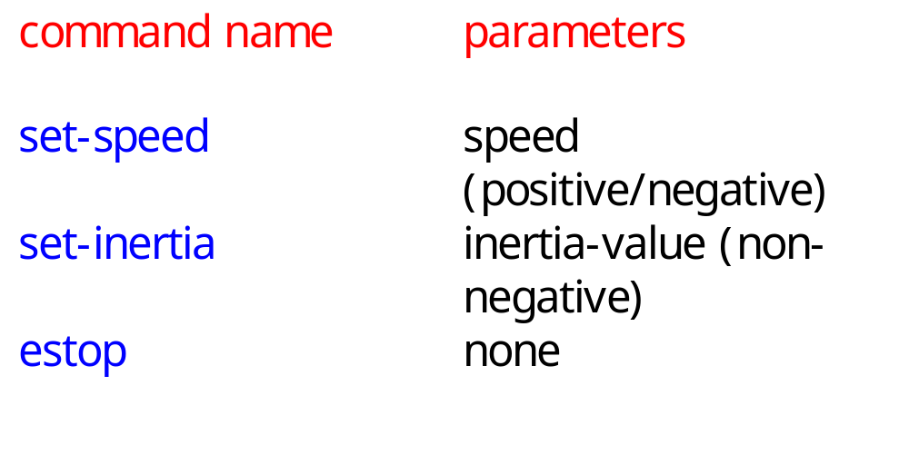
Basic system commands
© 2008 Wayne Wolf
Overheads for Computers as Components 2nd ed.

Slide 13
Typical control sequence
:console
:train_rcvr
set-inertia
set-speed
set-speed
estop
set-speed
© 2008 Wayne Wolf
Overheads for Computers as Components 2nd ed.

Slide 14
Message classes
command
set-speed
set-inertia
estop
value: integer
value: unsigned-
integer
© 2008 Wayne Wolf
Overheads for Computers as Components 2nd ed.

Slide 15
Roles of message classes
Implemented message classes derived from message class.
  Attributes and operations will be filled in for detailed specification.
Implemented message classes specify message type by their class.
  May have to add type as parameter to data structure in implementation.
© 2008 Wayne Wolf
Overheads for Computers as Components

Slide 16
Subsystem collaboration diagram
Shows relationship between console and receiver (ignores role of track):
1..n: command
:console
:receiver
© 2008 Wayne Wolf
Overheads for Computers as Components 2nd ed.

Slide 17
System structure modeling
Some classes define non-computer components.
  Denote by *name.
Choose important systems at this point to show basic relationships.
© 2008 Wayne Wolf
Overheads for Computers as Components 2nd ed.

Slide 18
Major subsystem roles
Console:
  read state of front panel;
  format messages;
  transmit messages.
Train:
  receive message;
  interpret message;
  control the train.
© 2008 Wayne Wolf
Overheads for Computers as Components 2nd ed.

Slide 19
Console system classes
console
1
1
1
1
1
1
panel
formatter
transmitter
1
1
1
1
receiver*
sender*
© 2008 Wayne Wolf
Overheads for Computers as Components 2nd ed.

Slide 20
Console class roles
panel: describes analog knobs and interface hardware.
formatter: turns knob settings into bit streams.
transmitter: sends data on track.
© 2008 Wayne Wolf
Overheads for Computers as Components 2nd ed.

Slide 21
Train system classes
train set
1
1..t
1
1
train
1
1
motor
interface
receiver
1
1
1
controller
1
1
1
detector*
pulser*
© 2008 Wayne Wolf
Overheads for Computers as Components 2nd ed.

Slide 22
Train class roles
receiver: digitizes signal from track.
controller: interprets received commands and makes control decisions.
motor interface: generates signals required by motor.
© 2008 Wayne Wolf
Overheads for Computers as Components 2nd ed.

Slide 23
Detailed specification
We can now fill in the details of the conceptual specification:
  more classes;
  behaviors.
Sketching out the spec first helps us understand the basic relationships in the system.
© 2008 Wayne Wolf
Overheads for Computers as Components 2nd ed.

Slide 24
Train speed control
Motor controlled by pulse width modulation:
duty
cycle
+
V
-
© 2008 Wayne Wolf
Overheads for Computers as Components 2nd ed.

Slide 25
Console physical object classes
knobs*
pulser*
train-knob: integer
speed-knob: integer
inertia-knob: unsigned-
integer
emergency-stop: boolean
pulse-width: unsigned-
integer
direction: boolean
sender*
detector*
send-bit()
read-bit() : integer
© 2008 Wayne Wolf
Overheads for Computers as Components 2nd ed.

Slide 26
Panel and motor interface classes
panel
motor-interface
speed: integer
train-number() : integer
speed() : integer
inertia() : integer
estop() : boolean
new-settings()
© 2008 Wayne Wolf
Overheads for Computers as Components 2nd ed.

Slide 27
Class descriptions
panel class defines the controls.
  new-settings() behavior reads the controls.
motor-interface class defines the motor speed held as state.
© 2008 Wayne Wolf
Overheads for Computers as Components 2nd ed.

Slide 28
Transmitter and receiver classes
transmitter
receiver
current: command
new: boolean
send-speed(adrs: integer,
speed: integer)
send-inertia(adrs: integer,
val: integer)
set-estop(adrs: integer)
read-cmd()
new-cmd() : boolean
rcv-type(msg-type:
command)
rcv-speed(val: integer)
rcv-inertia(val:integer)
© 2008 Wayne Wolf
Overheads for Computers as Components 2nd ed.

Slide 29
Class descriptions
transmitter class has one behavior for each type of message sent.
receiver function provides methods to:
  detect a new message;
  determine its type;
  read its parameters (estop has no parameters).
© 2008 Wayne Wolf
Overheads for Computers as Components 2nd ed.

Slide 30
Formatter class
formatter
current-train: integer
current-speed[ntrains]: integer
current-inertia[ntrains]:
unsigned-integer
current-estop[ntrains]: boolean
send-command()
panel-active() : boolean
operate()
© 2008 Wayne Wolf
Overheads for Computers as Components 2nd ed.

Slide 31
Formatter class description
Formatter class holds state for each train, setting for current train.
The operate() operation performs the basic formatting task.
© 2008 Wayne Wolf
Overheads for Computers as Components 2nd ed.

Slide 32
Control input cases
Use a soft panel to show current panel settings for each train.
Changing train number:
  must change soft panel settings to reflect current train’s speed, etc.
Controlling throttle/inertia/estop:
  read panel, check for changes, perform command.
© 2008 Wayne Wolf
Overheads for Computers as Components 2nd ed.

Slide 33
Control input sequence diagram
:knobs
:panel
:formatter
:transmitter
change in
control
settings
read panel
panel-active
change in speed/
inertia/estop
panel settings
send-command
read panel
send-speed,
send-inertia.
send-estop
panel settings
read panel
change in
train
number
change in
train number
panel settings
new-settings
set-knobs
© 2008 Wayne Wolf
Overheads for Computers as Components 2nd ed.

Slide 34
Formatter operate behavior
update-panel()
panel-active()
new train number
idle
send-command()
other
© 2008 Wayne Wolf
Overheads for Computers as Components 2nd ed.

Slide 35
Panel-active behavior
T
current-train = train-knob
update-screen
changed = true
panel*:read-train()
F
T
current-speed = throttle
changed = true
panel*:read-speed()
F
...
...
© 2008 Wayne Wolf
Overheads for Computers as Components 2nd ed.

Slide 36
Controller class
controller
current-train: integer
current-speed[ntrains]: integer
current-direction[ntrains]: boolean
current-inertia[ntrains]:
unsigned-integer
operate()
issue-command()
© 2008 Wayne Wolf
Overheads for Computers as Components 2nd ed.

Slide 37
Setting the speed
Don’t want to change speed instantaneously.
Controller should change speed gradually by sending several commands.
© 2008 Wayne Wolf
Overheads for Computers as Components 2nd ed.

Slide 38
Sequence diagram for set-speed command
:receiver
:controller
:motor-interface
:pulser*
new-cmd
cmd-type
rcv-speed
set-speed
set-pulse
set-pulse
set-pulse
set-pulse
set-pulse
© 2008 Wayne Wolf
Overheads for Computers as Components 2nd ed.

Slide 39
Controller operate behavior
wait for a
command
from receiver
receive-command()
issue-command()
© 2008 Wayne Wolf
Overheads for Computers as Components 2nd ed.

Slide 40
Refined command classes
command
type: 3-bits
address: 3-bits
parity: 1-bit
set-speed
set-inertia
estop
type=010
value: 7-bits
type=001
value: 3-bits
type=000
© 2008 Wayne Wolf
Overheads for Computers as Components 2nd ed.

Slide 41
Summary
Separate specification and programming.
  Small mistakes are easier to fix in the spec.
  Big mistakes in programming cost a lot of time.
You can’t completely separate specification and architecture.
  Make a few tasteful assumptions.
© 2008 Wayne Wolf
Overheads for Computers as Components 2nd ed.

